Slide 1
Graph Condensation for GNN through Gradient Matching
By: Swaroop Sridhar, Albert Bao, Misha Scokalo

Slide 2
Introduction

Slide 3
Paper Overview
Authors: Wei Jin, Lingxiao Zhao, Shichang Zhang, Yozen Liu, Jiliang Tang, Neil Shah
Main problem addressed: High computational cost of training Graph Neural Networks
Published: International Conference on Learning Representations, 2022
Notes:
These are the authors, I’m not going to butcher their names, but they are university faculty or snapchat employees.
Main problem addressed: High computational cost of training Graph Neural Networks
Published by ICLR

Slide 4
So, what is a Graph Neural Network?
Type of Neural Network designed to work over graphs
Many real world problems model as graphs
Applications
Social networks
Recommendation systems
Biological networks
etc…
Notes:
GNNs are specialized neural networks that operate on data structured as graphs. Unlike traditional neural networks that operate on flat data (like images or text), GNNs leverage the relationships and structure inherent in graph data.
Graphs consist of nodes (representing entities, like users or atoms) and edges (representing relationships, like friendships or chemical bonds).
GNNs are crucial because many real-world applications—such as social networks, recommendation engines, and drug discovery—are represented naturally as graphs. GNNs allow us to capture complex dependencies among interconnected data points.

Slide 5
What is Dataset Distillation & Condensation?
Dataset Distillation
Reducing a dataset
Retaining information
Dataset Condensation for GNNs
Create small, synthetic graphs
Fundamental Motivation:
Large graphs are computationally expensive
Condensation reduces size without sacrificing much accuracy
Notes:
Dataset distillation is a technique originally used to reduce image datasets by distilling essential information into a smaller set while retaining information.
For GNNs, this idea is adapted as "graph condensation," where a large, complex graph is condensed into a smaller synthetic graph that still allows a GNN to perform accurately.
This is important because training on large graphs requires significant computational resources and memory. Condensed datasets allow faster training and reduce the hardware requirements, making GNNs more accessible for large-scale problems.
Also, the synthetic graph is highly representative of the original graph which is why the gradient matching is effective.

Slide 6
Motivation

Slide 7
Challenges with Large-Scale Graphs
Social Networks (Social Media Platforms)
Billions of users (nodes) and connections (edges)
Complex user interactions
Dynamic and constantly changing/evolving structure
Molecular Graphs
Atoms (nodes) and chemical bonds (edges)
Critical for drug discovery
Citation Networks (Ogbn-arxiv)
169,343 nodes (papers)
1,166,243 edges (citations)
Complex web/rich feature implementation
E-commerce Networks
Users and products as nodes and purchases/rating interactions as the edges.
Complex web/rich feature implementation
Notes:
Graphs have become essential for large-scale data storage and analysis across multiple domains. Some of the key examples are:
In social networks like Facebook and Instagram, we deal with massive, computationally intensive networks where nodes represent users and edges represent their interactions.
The citation network example is interesting as well as it has over 169,000 academic papers as nodes and over 1.1 million citations as edges which demonstrates the scale.
In molecular graphs, we see another critical application where nodes represent atoms or compounds and edges represent chemical bonds. This structure is crucial for drug discovery and chemical analysis.
E-commerce networks present a unique case where users and products form bipartite graphs. As noted in paper we used, users made purchases based on specific product attributes, showing how graphs can effectively capture complex relationships in real-world scenarios.

Slide 8
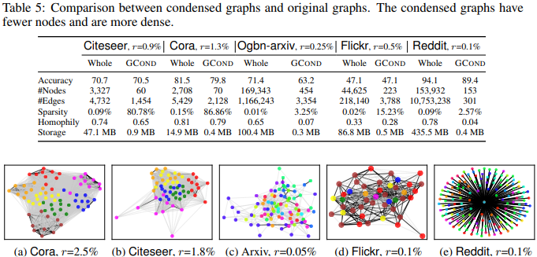
Computational Bottlenecks
Memory Constraints:
Storage Requirements:
Training Inefficiency:
Key Issues:
Message passing complexity being O(|E| × d) per layer
Multiple epochs needed for convergence
High amount of resource required for retraining
Limited by available CPU/GPU memory
Notes:
Let's look at the computational challenges we face:
The storage requirements are significant - our research shows Reddit needs 435.5 MB and Ogbn-arxiv requires 100.4 MB, primarily due to:
Adjacency matrices
Node feature matrices
Model parameters that scale with graph size
Training efficiency becomes particularly challenging because:
Models often need multiple retraining iterations for hyperparameter tuning
Neural architecture search requires extensive computational resources
GNNs require message passing across all nodes in each layer
Multiple training epochs are needed for convergence
These computational demands significantly constrain the scale of models we can train, especially with limited resources.

Slide 9
Need for Graph Condensation
Benefits:
Demonstrated Results:
99.9% reduction in graph size
Maintains ~95-99% of original accuracy
Significant speed-up in training time
Reduced memory requirements
Challenges
Critical Considerations:
Preserving graph topology
Maintaining node feature relationships
Balancing size reduction vs performance
Notes:
This brings us to graph condensation. Our research has shown remarkable benefits:
In terms of storage efficiency, we've achieved dramatic reductions. For example, the Reddit dataset was reduced from 435.5 MB to just 0.4 MB while retaining 95.3% of the original accuracy.
However, we must carefully consider several challenges:
Maintaining important topological properties
Preserving node feature correlations
Finding the right balance between size reduction and model performance
Developing effective algorithms for the condensation process
These considerations are crucial for ensuring our condensed graphs remain useful for downstream tasks while providing the computational benefits we seek.

Slide 10
Methodology

Slide 11


Problem Formulation
Given that we have a graph dataset T = {A,X,Y}, where:
A is an NxN adjacency Matrix, representing the original graph, where N denotes the number of nodes
denotes a set of input feature vectors associated with every node in the graph
denotes the label associated with each input feature vector x
Objective: generate synthetic graph dataset S = {A’,X’,Y’}, with number of nodes N’ << N, while retaining performance

Slide 12
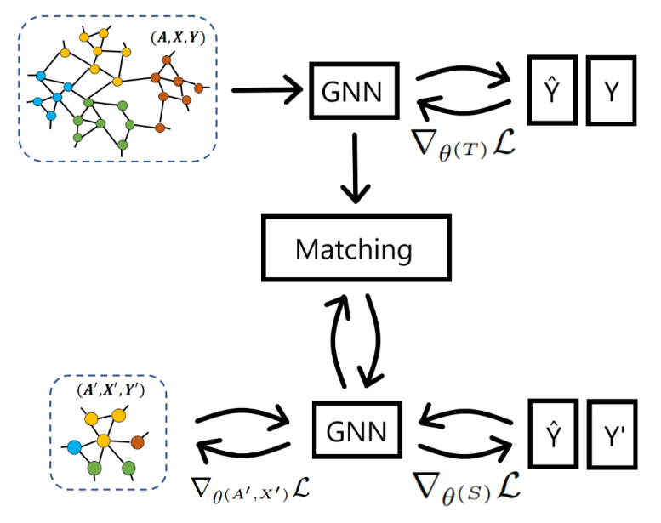
Objective
Objective:
Intuitively, we would try:
What we have here? A nested loop!
Notes:
So what does it mean by Retaining the Performance? Let’s formulate it into an actual Math problem
Essentially we’re minimizing the loss of the model on the original graph that is trained on the synthetic graph
By intuition, we would try this paradigm, may be with gradient descent, but this leads to a nested loop which creates a severe computational overhead

Slide 13

Alternatively, we match the model Parameters
By matching parameters of GNN models trained on original graph & synthetic graph respectively, the problem becomes:
Where D is a distance function
Notes:
Alternatively, instead of solving the bi-level optimization problem in the previous slides
We would match the parameters of the GNN model trained on Original graph and Synthetic graph, respectively, in each training step
While in the equation above, D denotes the distance function, and we’re essentially minimizing the gap between those parameters

Slide 14
Gradient Matching
If we’re optimizing the GNN Model parameter with gradient descent:
Simplify the objective into matching the gradient in each iteration:
And calculate the {A’, X’, Y’} accordingly.
Note: jointly learning A’, X’ , Y’ would be challenging, we sample Y’ from Y and fix it
Notes:
Based on the new paradigm in the previous slide, if we’re training these GNN models by gradient descent,
Instead of matching the entire model parameter, we can essentially match their gradient update in each training step And calculate the synthetic graph through backward propagation (going through the diagram while explaining shits)
However, jointly learning the adjacency matrix, the feature vectors and set of labels would be challenging in practice
Therefore, instead of learning the label set, we sample it from Original graph and fix it throughout the entire training trajectory

Slide 15

Another Challenge
Treating A’ and X’ as free trainable parameter would be computationally expensive
Thus, we parameterize A’ with Multi Layer Perceptron
And thus we have:
Notes:
Right now, we have an attainable paradigm of synthetic graph generation, but there’s another challenge that needed to be fixed:
Treating the adjacency matrix and feature vectors as free trainable param -> expensive
Since as the number of nodes in the synthetic graph increases, the parameters in Adjacency matrix would increase quadratically,
Plus, this overlooked the correlation between graph structure and features
Therefore, we need to parameterize the adjacency matrix A’ with a multi-layer perception, that takes the feature vector as an input, and output its corresponding weight of the edge. The definition of the matrix might looks a bit overwhelming, but essentially it’s modeling the weight of the edge connecting node i and node j from their associated feature, and also since most graphs are undirected, the edge IJ and edge JI should share the same weight
And thus, with the parameterization of the adjacency matrix, we’re learning the feature vector and MLP parameters from minimizing the gradient gap in every training step.

Slide 16
Experiments

Slide 17
Data Condensation Trials
CORA dataset
Manageable size
High homophily
Original graph: 2,708 nodes, 5,429 edges, and 7 classes
1.3%: 5 nodes, 10 edges
2.6%: 10 nodes, 21 edges
5.2%: 40 nodes, 42 edges
Notes:
a global oceanographic temperature and salinity dataset produced and maintained by the French institute IFREMER
Cora was chosen due to its smaller size and high homophily (nodes are more likely to connect to others with the same label/class)
compared to something like obgn arxiv with 160k+ nodes and 1m+ edges, so could actually run trials in a reasonable time
Easier to test how well condensation preserves important properties, such as label distribution and graph structure, which are key for many downstream tasks

Slide 18
Coreset Selection Methods (Baseline)
Random
Selects nodes and edges randomly to create a condensed graph
Herding
Selects components to best summarize the feature distribution of the entire dataset
K-Center
Selects graph elements closest to the cluster centers
Notes:
Coreset selection methods were tested against our GCond implementation
Random selection speaks for itself
Herding: deterministically produces a sequence of “samples” whose moments rapidly converge to the moments of the given data set using maximum likelihood estimation
a method of estimating the parameters of an assumed probability distribution
Seeks to minimize the distance between a selected component and the center of its cluster, for k clusters

Slide 19
Training & Evaluation
200 epochs for the coreset selection methods – 1500 for GCond
High RAM CPU in google colaboratory
Dependency issues
Evaluation
Evaluation (e.g train-test splits) was done in line with the paper
Notes:
Used 1500 for GCond to make sure we reached optimal convergence where possible

Slide 20
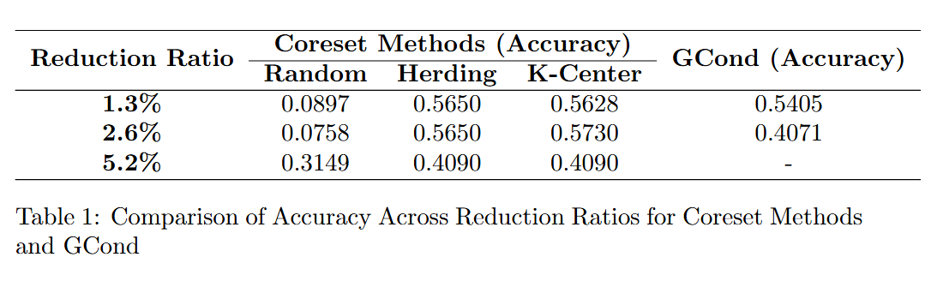
Results
GCond maintains comparable performance at lower condensation ratios
K-Center still leading, but not by much
Notes:
At low condensation ratios, our GCond implementation did very well
Why GCond does best at low condensation ratios
Larger condensed graphs increase parameter complexity, leading to potential overfitting or suboptimal convergence
Adding nodes and edges might introduce noise, reducing the representativeness of the condensed graph.
Larger graphs make it harder to effectively match gradients, reducing training fidelity
Plus general saturation effect, after a certain point, more nodes and edges add diminishing value and might even harm performance
At 2.6%, we could not run as many trials, because

Slide 21
Reported Observations from Jin et al.
Significantly reduce graph size while approximating original results
Condensing node features and structural information simultaneously can lead to better performance
Larger condensed graph size does not strictly indicate better performance
Notes:
Does not match original results, but gets close (promising performance)
Although larger condensed graph sizes allow for more parameters which can potentially encapsulate more information from original graph, it simultaneously becomes harder to optimize due to the increased model complexity

Slide 22
Problem Set

Slide 23
Theoretical Foundations
Part (a) Write out the mathematical formulation for the gradient matching objective in graph condensation.
Explain each term in the equation.
Consider a graph G with N nodes, E edges, and F -dimensional node features.

Slide 24
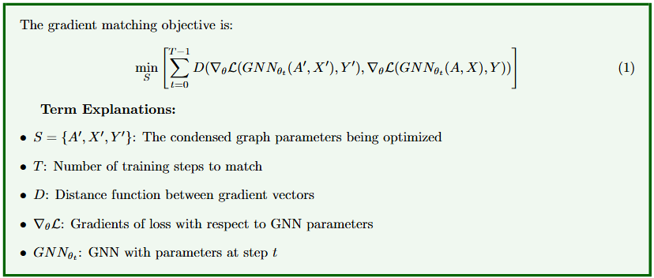

Slide 25
Part (b)
Why is gradient matching preferred over directly optimizing the bi-level objective? Discuss the computational implications.

Slide 26
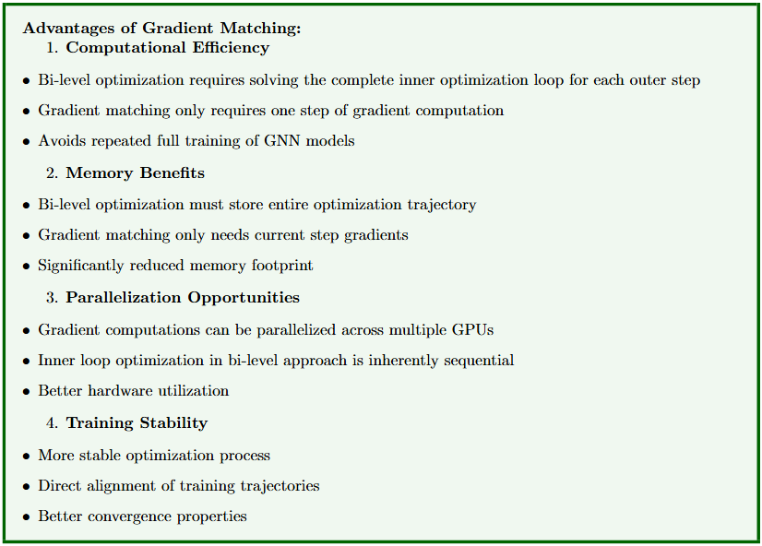

Slide 27
Part (c)
In graph condensation, we model the condensed adjacency matrix A′ as a function of condensed node features X′. Write out this relationship and explain why this parameterization is beneficial compared to treating A′ as free parameters.

Slide 28
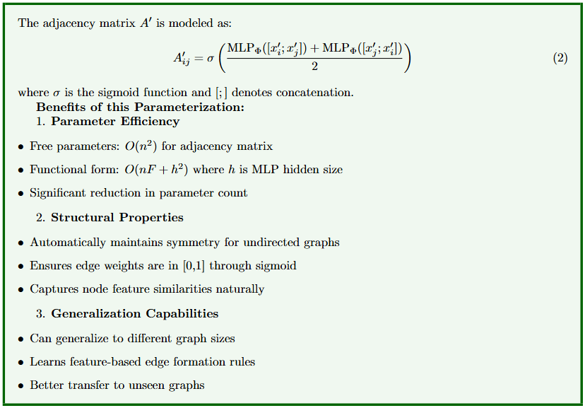

Slide 29
Part (d) Calculate the number of parameters needed to represent:
• A condensed graph with free parameters for both A′ and X′
• A condensed graph using the functional relationship A′ = gΦ(X′)
Express your answer in terms of n (number of condensed nodes), F (feature dimension), and h (hidden dimension of Φ).

Slide 30
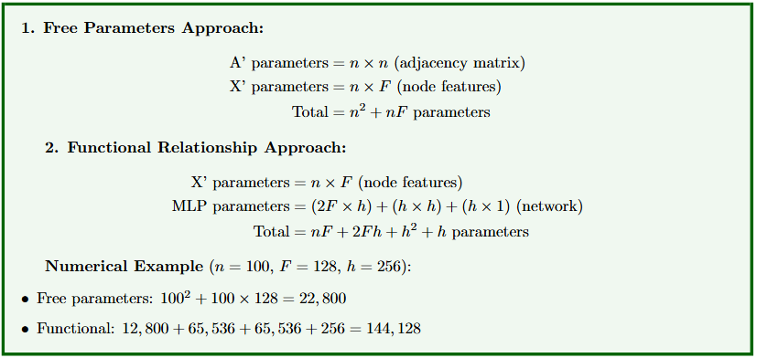

Slide 31
Part (e)
Prove that if the original graph G is undirected, the functional form used for A′ = gΦ(X′) in the paper maintains symmetry.

Slide 32
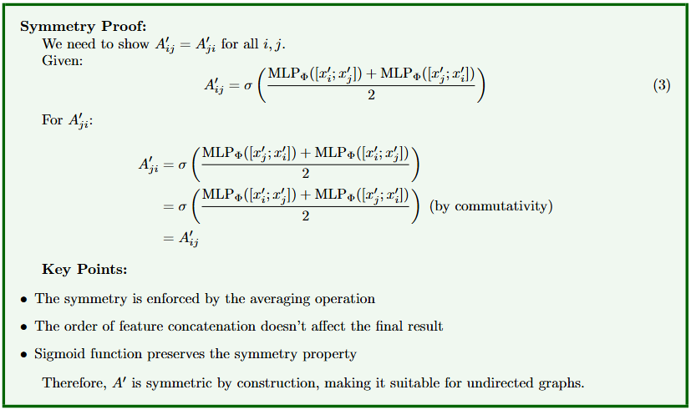

Slide 33
Questions?

